Slide 1
Amazon bd
Website

Slide 2
Team member’s
MD.Tanvir Ahamed. ID:221-15-5864
MD.Anisour Rahaman. ID:221-15-5636

Slide 3
Feature
1. Schedule your delivery
2. Get a refund when packages are late.
3. Get discounts by subscribing.
4. Digital dash buttons
7. Donate to charity
8. online Payment
9. Total 12 page fore product

Slide 4
Our System
Our System is an e-commerce website from where people can buy online.
► Admin monitors the activity of the users and checks the transactions.

Slide 5
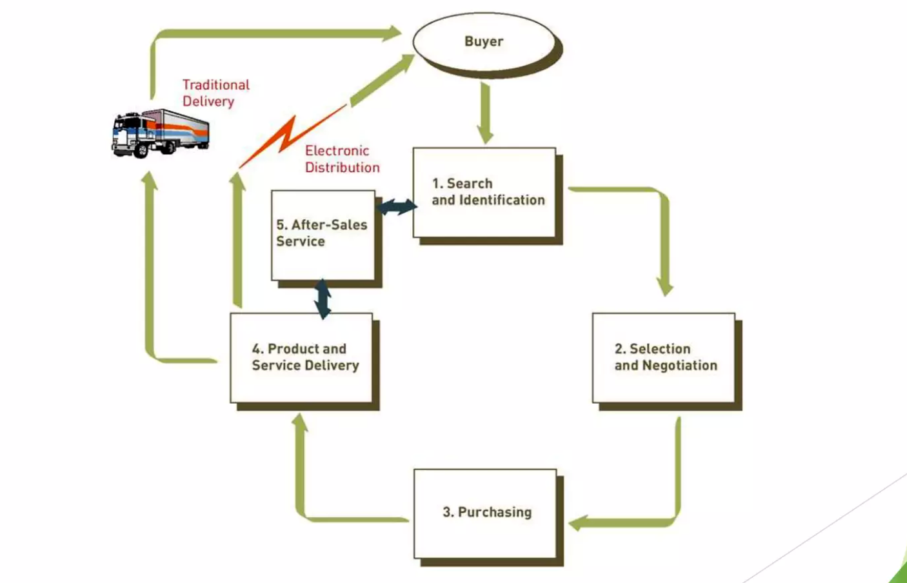
The process of e-commerce

Slide 6
Menu
* Catalog Browsing
Category List
Product List
* Catalog Management
* Product Browsing
Product Reviews
Related Products
* Shopping Cart
❖ Checkout
* Auto generated bill
* Payment Gateway

Slide 7
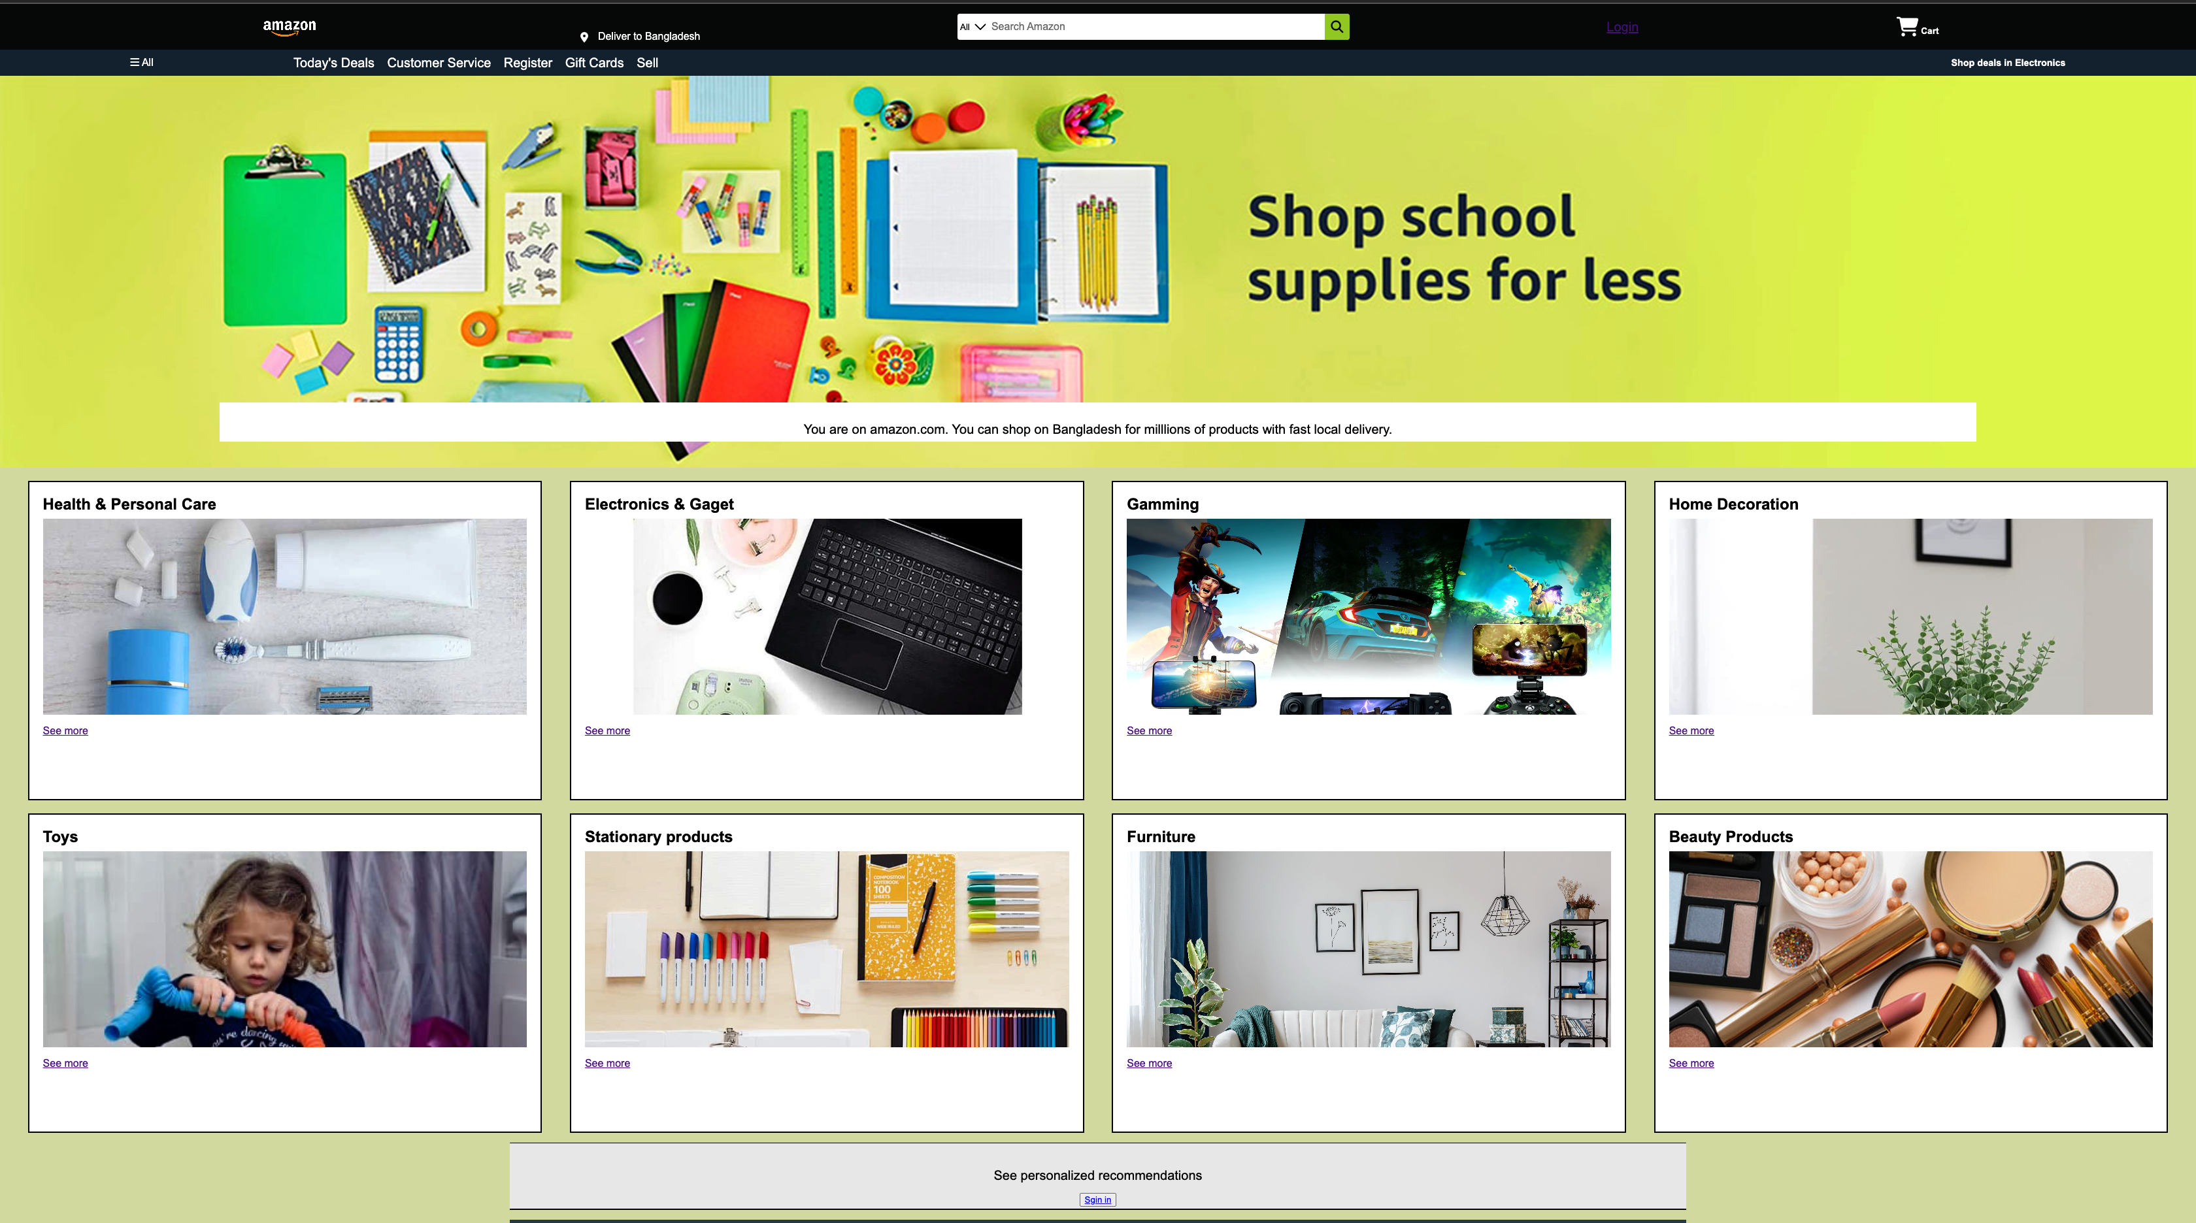
Home Page

Slide 8
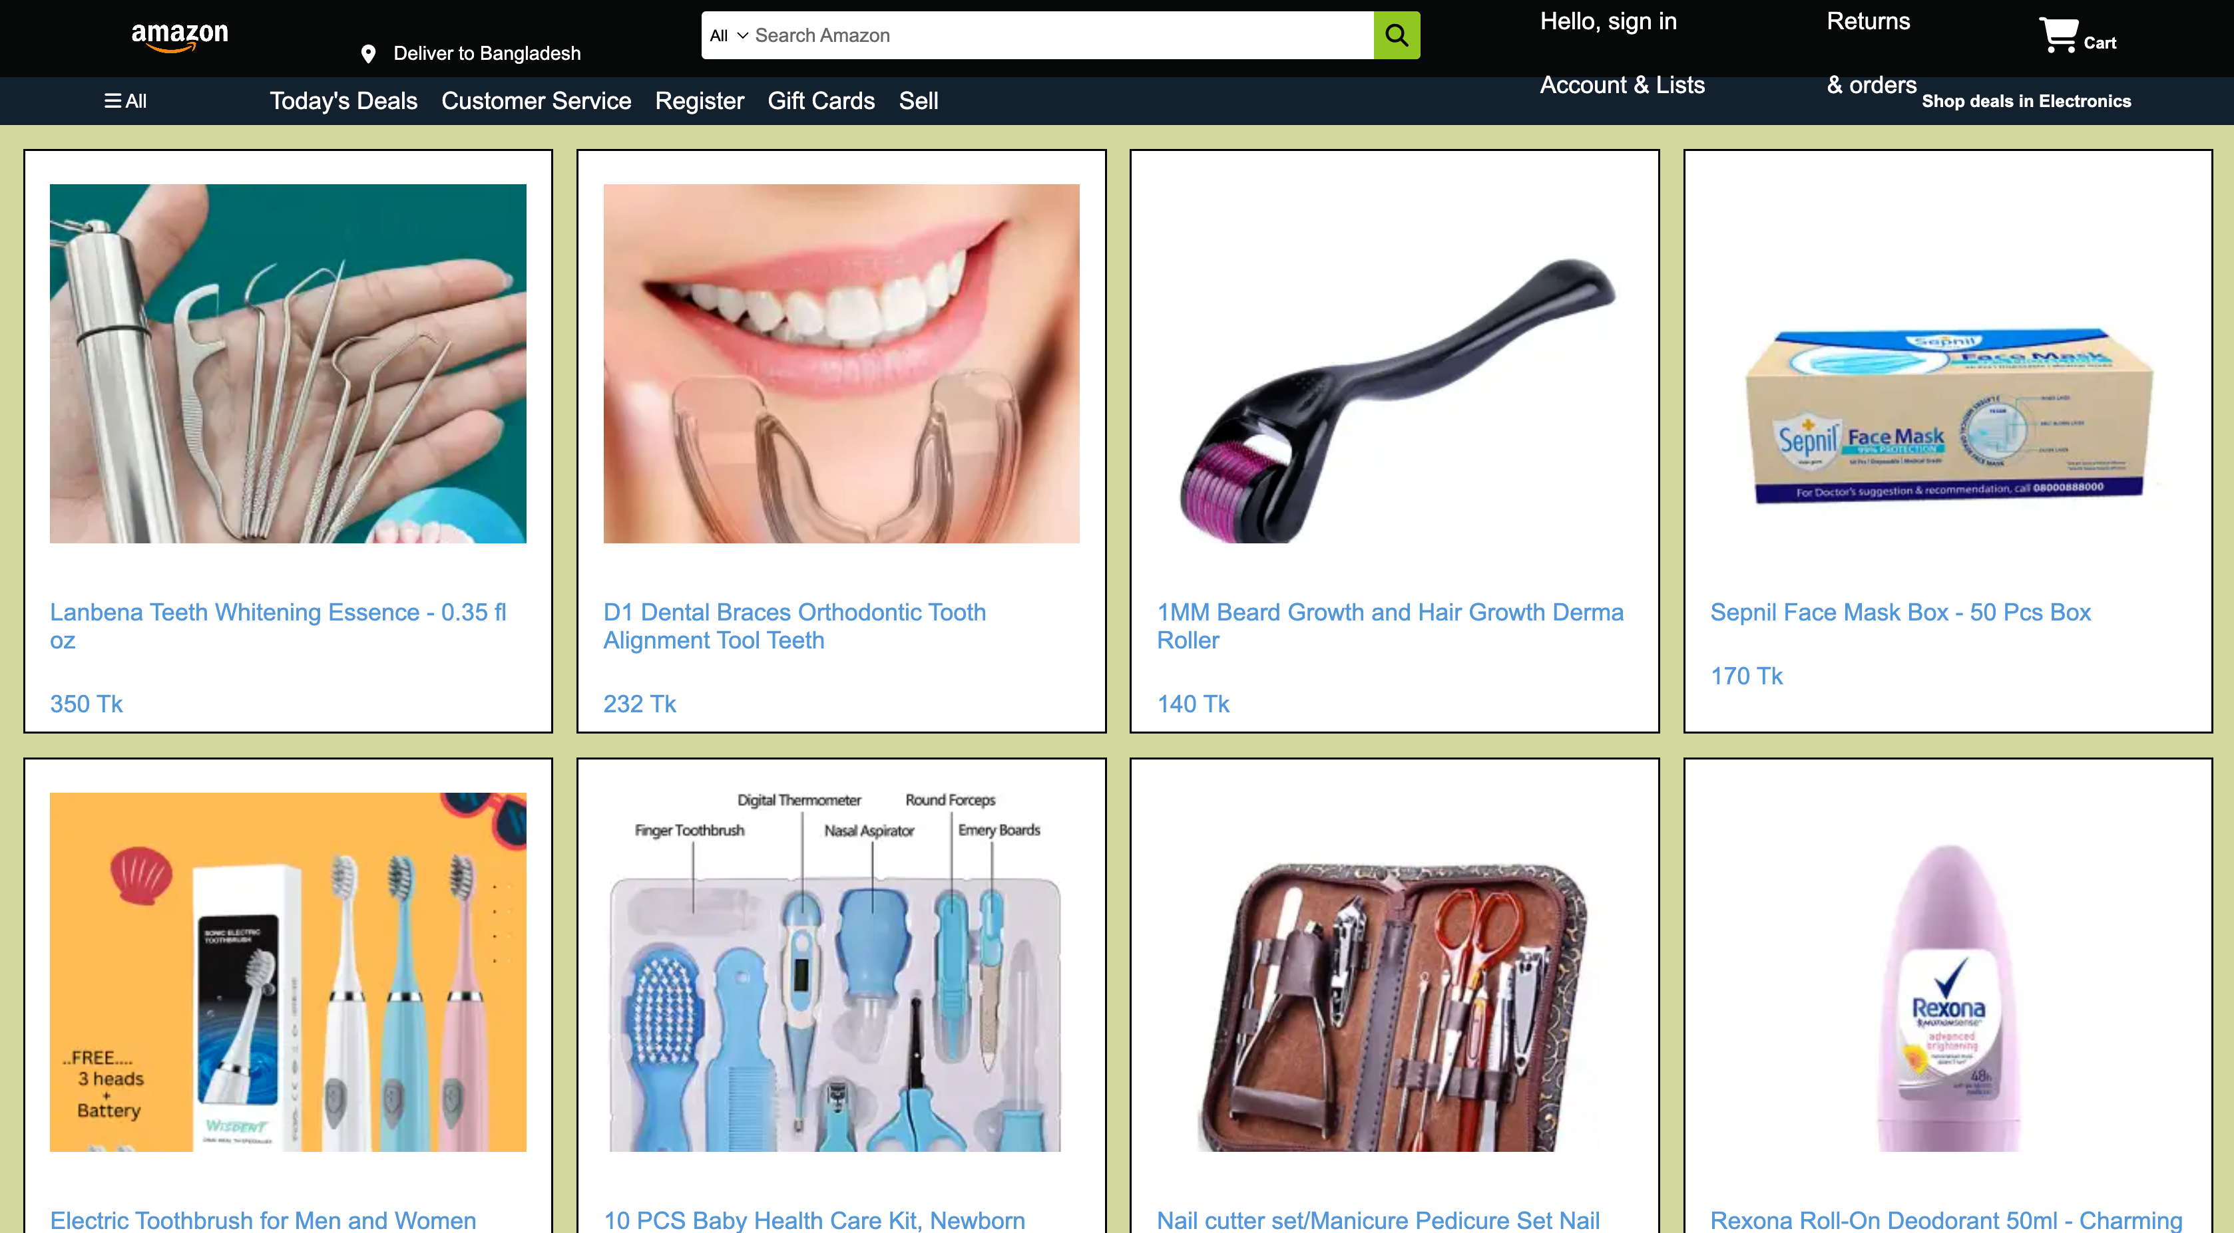
Tab 1

Slide 9
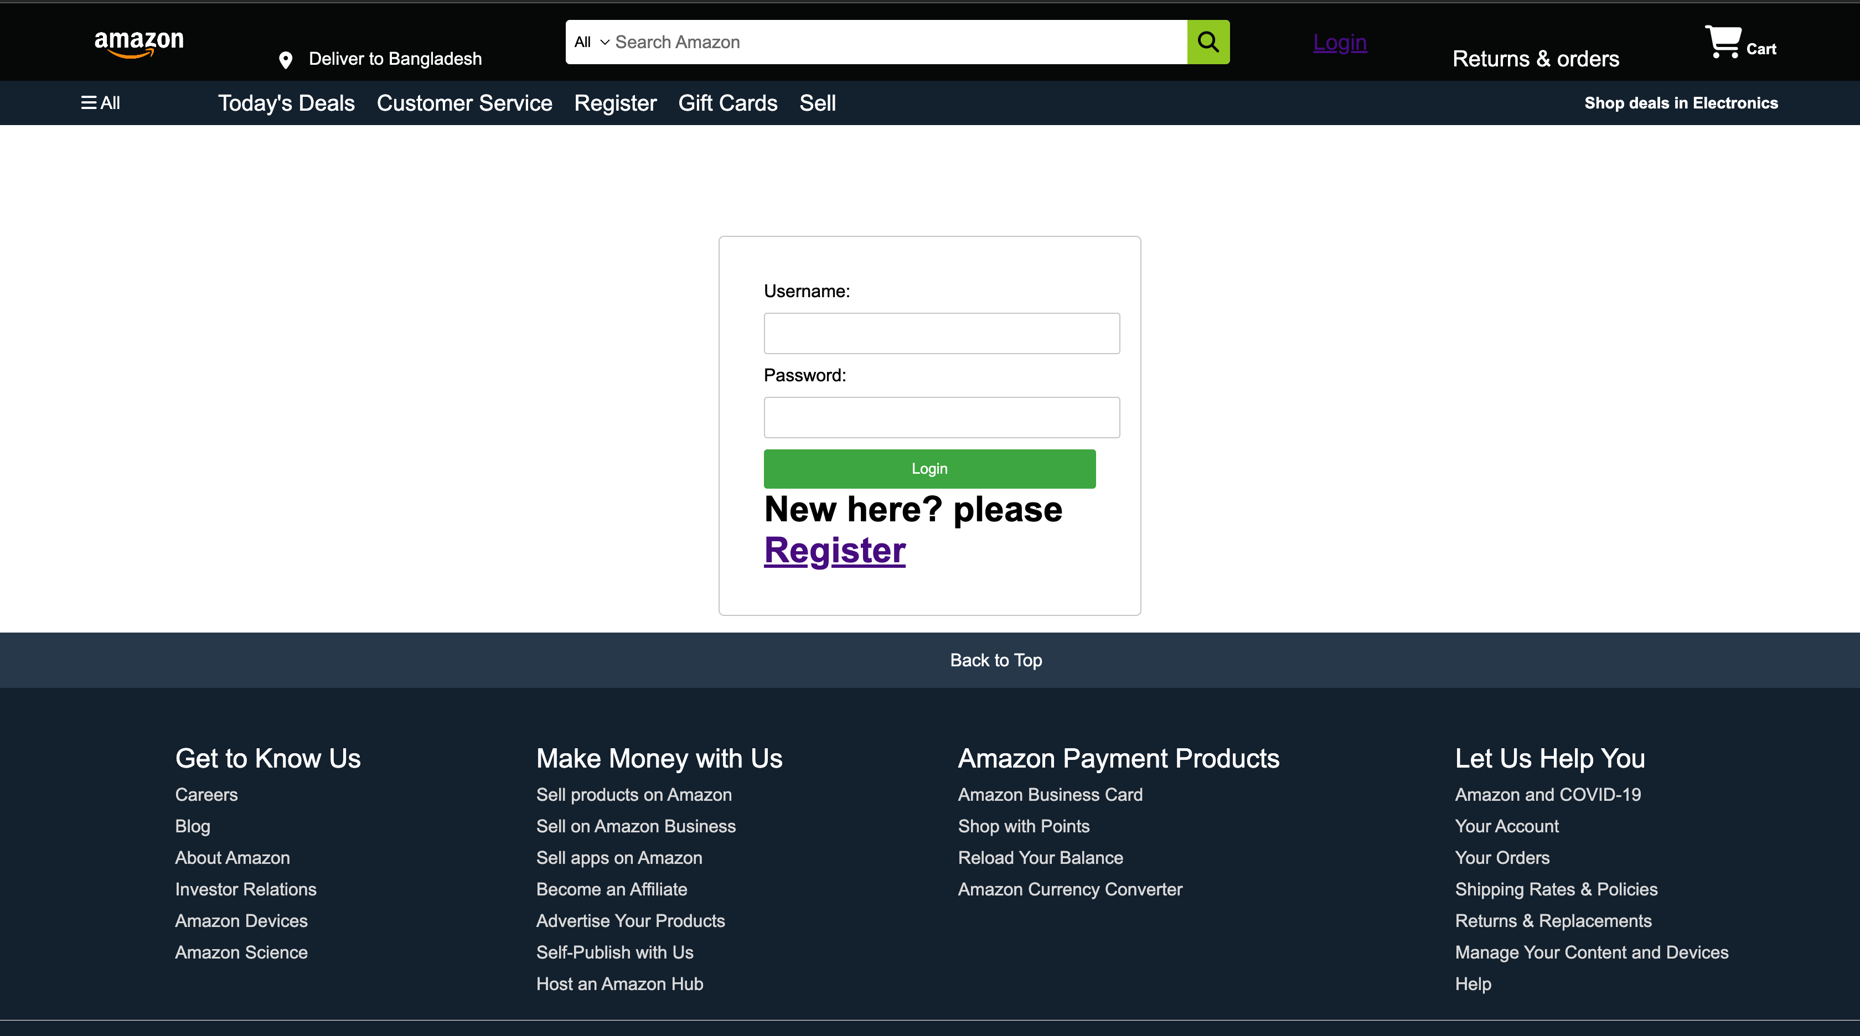
Login page

Slide 10
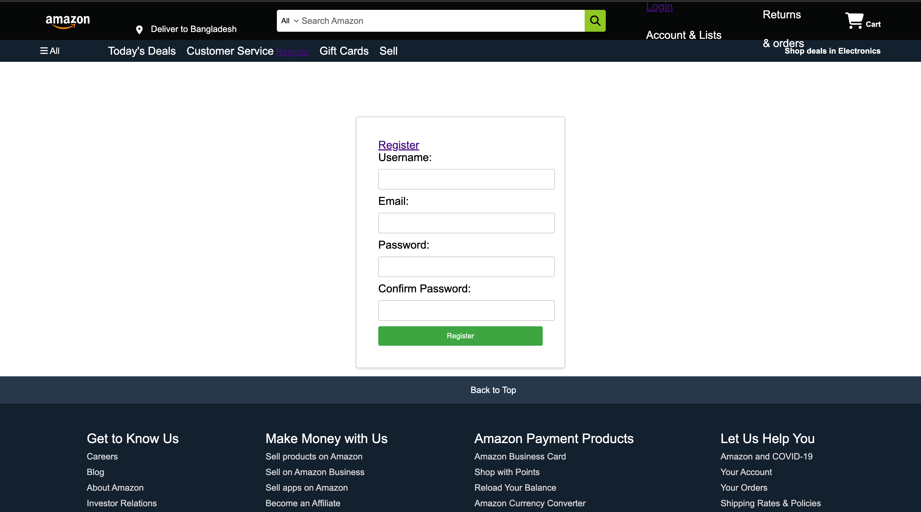
Register page

Slide 11
Thank you

